Slide 1
Chapter 12
Processor Structure and Function

Slide 2
Central Processing Unit
3.1 | CPU architecture, Register organization, Instruction formats and addressing modes(Intel processor).,Basic instruction cycle. Control unit Operation ,Micro operations : Fetch, Indirect, Interrupt , Execute cycle Control of the processor, Functioning of micro programmed control unit, Micro instruction Execution and Sequencing, Applications of Micro programming
3.2 | RISC v/s CISC processors, RISC and CISC Architecture, RISC pipelining, Case study on SPARC

Slide 3
CPU Structure
CPU must:
  Fetch instructions
  Interpret instructions
  Fetch data
  Process data
  Write data
Notes:
22

Slide 4
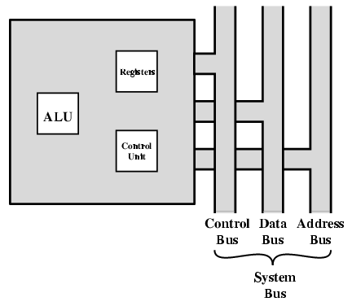
CPU With Systems Bus

Slide 5
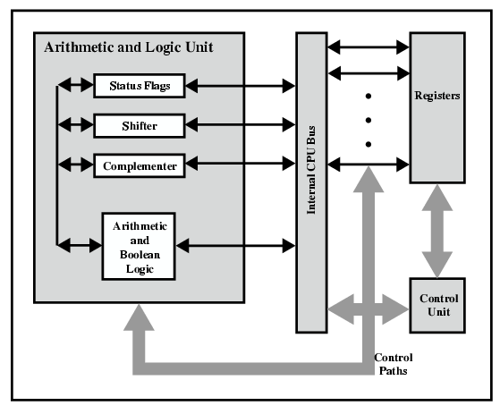
CPU Internal Structure

Slide 6
Registers
CPU must have some working space (temporary storage)
Called registers
Number and function vary between processor designs
One of the major design decisions
Top level of memory hierarchy
Notes:
23

Slide 7
User Visible Registers
General Purpose
Data
Address
Condition Codes
Notes:
24

Slide 8

Example Register Organizations

Slide 9
General Purpose Registers
May be true general purpose
May be restricted
May be used for data or addressing
Data
  Accumulator
Addressing
  Segment
Notes:
25

Slide 10
Why make them general purpose?
  Increase flexibility and programmer options
  Increase instruction size & complexity
Notes:
26

Slide 11
How big?
Large enough to hold full address
Large enough to hold full word
Often possible to combine two data registers
  C programming
  double int a;
  long int a;
Notes:
28

Slide 12
Condition Code Registers(Flag Reg)
Sets of individual bits
  e.g. result of last operation was zero
Can be read (implicitly) by programs
  e.g. Jump if zero
Can not (usually) be set by programs
Notes:
29

Slide 13
Control & Status Registers
Program Counter (PC)
Instruction Decoding Register(IR)
Memory Address Register(MAR)
Memory Buffer Register(MBR)
Notes:
30

Slide 14
Registers
Memory Address Register (MAR)
  Connected to address bus
  Specifies address for read or write op
Memory Buffer Register (MBR)
  Connected to data bus
  Holds data to write or last data read
Program Counter (PC)
  Holds address of next instruction to be fetched
Instruction Register (IR)
  Holds last instruction fetched/current instruction being executed

Slide 15
Program Status Word
A set of bits
Includes Condition Codes
Sign of last result
Zero
Carry
Equal
Overflow
Interrupt enable/disable
Supervisor
Notes:
31

Slide 16
General Registers
AX is the primary accumulator; it is used in input/output and most arithmetic instructions. For example, in multiplication operation, one operand is stored in EAX or AX or AL register according to the size of the operand.
BX is known as the base register, as it could be used in indexed addressing.
CX is known as the count register, as the ECX, CX registers store the loop count in iterative operations.
DX is known as the data register. It is also used in input/output operations. It is also used with AX register along with DX for multiply and divide operations involving large values.

Slide 17
Pointer Registers
Instruction Pointer (IP) − The 16-bit IP register stores the offset address of the next instruction to be executed. IP in association with the CS register (as CS:IP) gives the complete address of the current instruction in the code segment.
Stack Pointer (SP) − The 16-bit SP register provides the offset value within the program stack. SP in association with the SS register (SS:SP) refers to be current position of data or address within the program stack.
Base Pointer (BP) − The 16-bit BP register mainly helps in referencing the parameter variables passed to a subroutine. The address in SS register is combined with the offset in BP to get the location of the parameter. BP can also be combined with DI and SI as base register for special addressing.

Slide 18
Index Registers
SI and DI, are used for indexed addressing and sometimes used in addition and subtraction.
There are two sets of index pointers −
Source Index (SI) − It is used as source index for string operations.
Destination Index (DI) − It is used as destination index for string operations.

Slide 19
Control Registers
The 32-bit instruction pointer register and the 32-bit flags register combined are considered as the control registers.
Many instructions involve comparisons and mathematical calculations and change the status of the flags and some other conditional instructions test the value of these status flags to take the control flow to other location.
The common flag bits are:

Slide 20
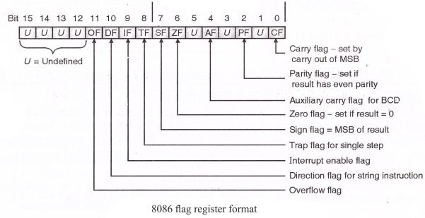
FLAG REGISTER 8086

Slide 21
Overflow Flag (OF) − It indicates the overflow of a high-order bit (leftmost bit) of data after a signed arithmetic operation.
Direction Flag (DF) − It determines left or right direction for moving or comparing string data. When the DF value is 0, the string operation takes left-to-right direction and when the value is set to 1, the string operation takes right-to-left direction.

Slide 22
Trap Flag (TF) − It allows setting the operation of the processor in single-step mode. The DEBUG program we used sets the trap flag, so we could step through the execution one instruction at a time.
Sign Flag (SF) − It shows the sign of the result of an arithmetic operation. This flag is set according to the sign of a data item following the arithmetic operation. The sign is indicated by the high-order of leftmost bit. A positive result clears the value of SF to 0 and negative result sets it to 1.
Zero Flag (ZF) − It indicates the result of an arithmetic or comparison operation. A nonzero result clears the zero flag to 0, and a zero result sets it to 1.

Slide 23
Interrupt Flag (IF) − It determines whether the external interrupts like keyboard entry, etc., are to be ignored or processed. It disables the external interrupt when the value is 0 and enables interrupts when set to 1.

Slide 24
Auxiliary Carry Flag (AF) − It contains the carry from bit 3 to bit 4 following an arithmetic operation; used for specialized arithmetic. The AF is set when a 1-byte arithmetic operation causes a carry from bit 3 into bit 4.
Parity Flag (PF) − It indicates the total number of 1-bits in the result obtained from an arithmetic operation. An even number of 1-bits clears the parity flag to 0 and an odd number of 1-bits sets the parity flag to 1.
Carry Flag (CF) − It contains the carry of 0 or 1 from a high-order bit (leftmost) after an arithmetic operation. It also stores the contents of last bit of a shift or rotate operation.

Slide 25
Segment Registers
Segments are specific areas defined in a program for containing data, code and stack. There are three main segments −
Code Segment − It contains all the instructions to be executed. A 16-bit Code Segment register or CS register stores the starting address of the code segment.
Data Segment(DS,ES) − It contains data, constants and work areas. A 16-bit Data Segment register or DS register stores the starting address of the data segment.
Stack Segment − It contains data and return addresses of procedures or subroutines. It is implemented as a 'stack' data structure. The Stack Segment register or SS register stores the starting address of the stack.

Slide 26
INSTRUCTION FORMAT
(PENTIUM)
Instruction :- MOV A (Destination),B(Source)
Examples:
MOV AX,BX
Add AX,4
JMP
MUL 3,5
Opcodes-Operation Code
Operands-Data
→Instruction=Opcodes+Operands.

Slide 27
Instruction Formats
Layout of bits in an instruction
Includes opcode
Includes (implicit or explicit) operand(s)
Usually more than one instruction format in an instruction set

Slide 28
Instruction Length
Affected by and affects:
  Memory size
  Memory organization
  Bus structure
  CPU complexity
  CPU speed
  User wants more opcodes, operands, addressing modes , address range

Slide 29
Allocation of Bits
Number of addressing modes
Number of operands
Register versus memory
Number of register sets
Address range
Address Granularity

Slide 30
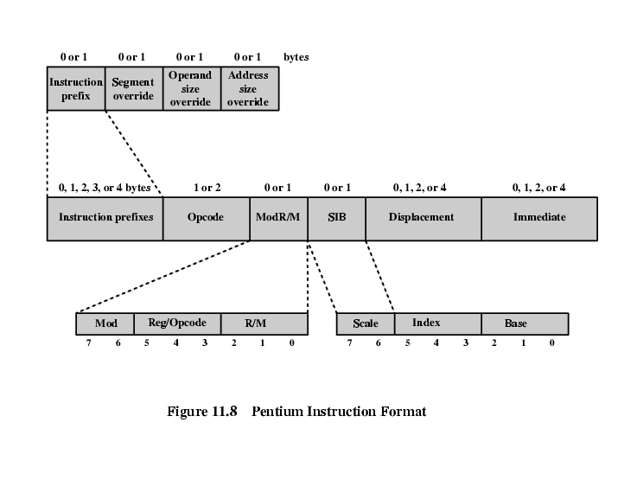
Pentium Instruction Format

Slide 31
PENTIUM INSTRUCTION FORMAT
Instruction Prefixes-LOCK prefix or one of the REPEAT prefixes(REPE,REPNE,REPZ,REPNZ….)
Segment Override-explicitly specifying segment register
Address Size-16 or 32 bit (switch)
Operand Size-16 or 32 bit (switch)

Slide 32
PENTIUM INSTRUCTION FORMAT
Opcode
Mod R/m-addressing
  Mod+ r/m (combined info of registers and addressing modes)
  Register-register or opcode info
SIB
  Scale-scale factor for scaled indexing
  Index-specifies index register(SI,DI)
  Base-specifies base register(BX)
Displacement-8 or 16 or 32 bit
Immediate-provides the value of 8/16/32 bit operand

Slide 33
PENTIUM INSTRUCTION FORMAT
Instruction Prefixes-LOCK prefix or one of the REPEAT prefixes
Segment Override-explicitly specifying segment register
Address Size-16 or 32 bit (switch)
Operand Size-16 or 32 bit (switch)

Slide 34
William Stallings
Computer Organization and Architecture
6th Edition
Chapter 11
Instruction Sets:
Addressing Modes and Formats

Slide 35
Addressing Modes
Immediate
Direct
Indirect
Register
Register Indirect
Displacement (Indexed)
Stack
Notes:
2

Slide 36
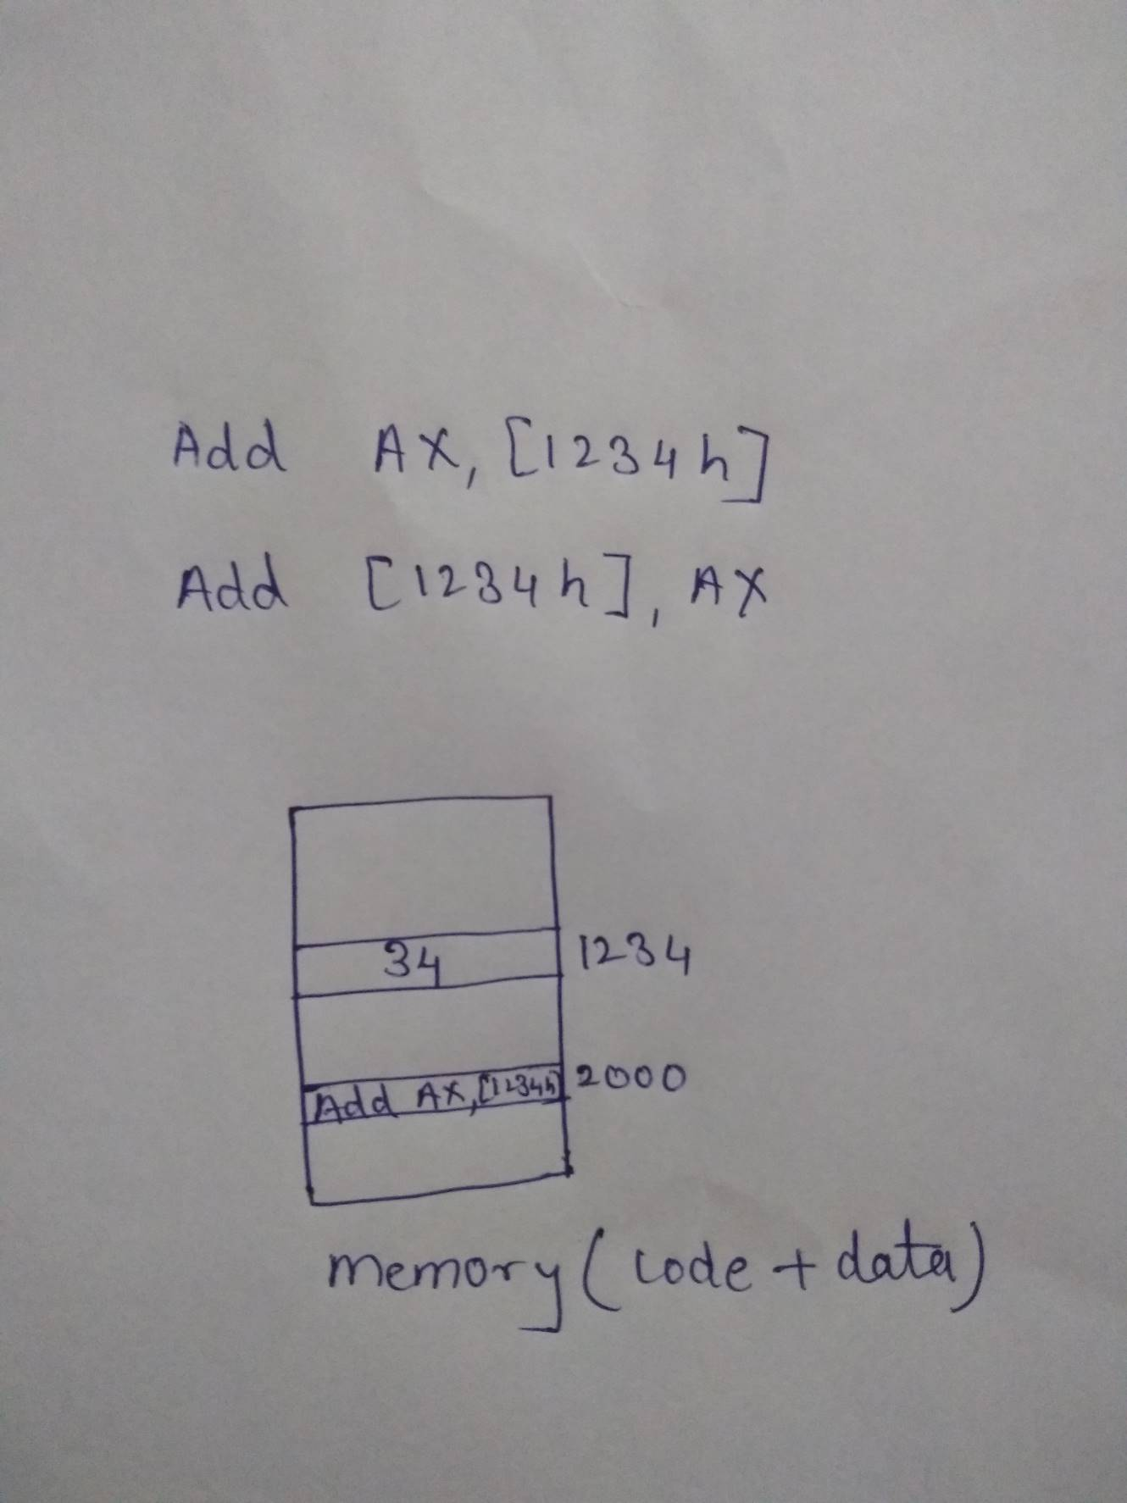


Slide 37
Addressing Modes
8086 accesses data operands in different ways.
When 8086 executes an instruction , it performs specific function on data(operand).
Operands may be contained in registers, within the instruction itself, in memory or in I/O ports.
To access these different types of operands ,8086 has to address memory or I/O.
The address of memory and I/O can be calculated in several different ways, referred as Addressing Modes.
Notes:
2

Slide 38
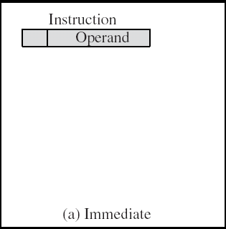
Immediate Addressing
In this mode data is present in address field of instruction .
Designed like one address instruction format
  Note:Limitation in the immediate mode is that the range of constants are restricted by size of address field.
FEATURES
  Operand is part of instruction
  Operand = address field
  No memory reference to fetch data
  Fast
  Limited range
Notes:
3

Slide 39
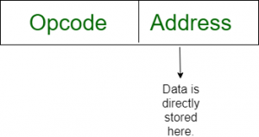
MOV AX, #2000
MOV CL, 0Ah
ADD AL, #45
ADD AX, 0000
MOV CX, 4929 H
ADD AX, 2387 H,
MOV AL, FFH

Slide 40
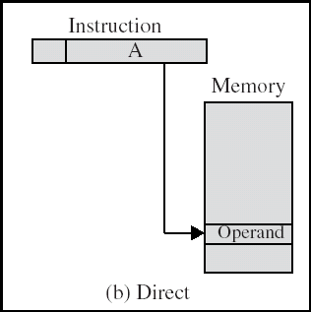
Direct(M) Addressing Diagram
Notes:
6

Slide 41

MOV AX, [200h]
ADD [1234H],AX
MOV AX, [0500h]
ADD AL,[0301]

Slide 42
The operand’s offset is given in the instruction as an 8 bit or 16 bit displacement element.
In this addressing mode the 16 bit effective address of the data is the part of the instruction.
Here only one memory reference operation is required to access the data.

Slide 43
Direct Addressing
Address field contains address of operand
EFFECTIVE ADDRESS EA = address field (A)
  Look in memory at address value for operand
Single memory reference to access data
No additional calculations to work out effective address
Limited address space
Notes:
5

Slide 44
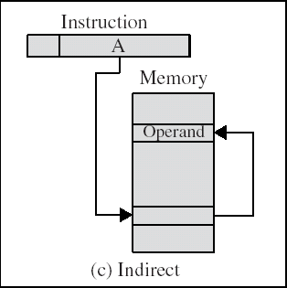
Indirect Addressing Diagram
Notes:
9

Slide 45
In this mode address field of instruction contains the address of effective address.
Here two references are required.
1st reference to get effective address.
2nd reference to access the data.
.

Slide 46
Based on the availability of Effective address, Indirect mode is of two kind:
REGISTER INDIRECT: In this mode effective address is in the register, and corresponding register name will be maintained in the address field of an instruction.
  Here one register reference,one memory reference is required to access the data.

Slide 47
MEMORY INDIRECT: In this mode effective address is in the memory, and corresponding memory address will be maintained in the address field of an instruction.
  Here two memory reference is required to access the data

Slide 48
Indirect Addressing (1/2)
Memory cell pointed to by address field contains the address of (pointer to) the operand
EA =(A)
  Look in A, find address (A) and look there for operand
e.g. ADD AX, (A)
  Add contents of cell pointed to by contents of A to accumulator
Notes:
7

Slide 49
Indirect Addressing (2/2)
Large address space
2^{n} where n = word length
May be nested, multilevel, cascaded
  e.g. EA = (((A)))
    Draw the diagram yourself
Multiple memory accesses to find operand
Hence slower
Notes:
8

Slide 50
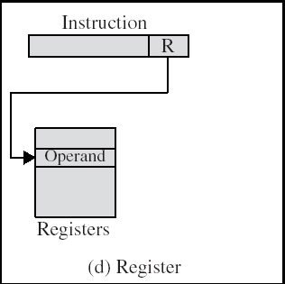
Register Addressing Diagram
Notes:
12

Slide 51

In register addressing the operand is placed in one of 8 bit or 16 bit general purpose registers.
The data is in the register that is specified by the instruction.
  Here one register reference is required to access the data.

Slide 52
Register Addressing (1/2)
Operand is held in register named in address filed
EA = R
Limited number of registers
Very small address field needed
  Shorter instructions
  Faster instruction fetch
  MOV AX, BX
  ADD AX, BX
Notes:
10

Slide 53
Register Addressing (2/2)
No memory access
Very fast execution
Very limited address space
Multiple registers helps performance
  Requires good assembly programming or compiler writing
  N.B. C programming
    register int a;
c.f. Direct addressing
Notes:
11

Slide 54
Register Indirect Addressing Diagram
Notes:
14

Slide 55

In this addressing the operand’s offset is placed in any one of the registers BX,BP,SI,DI as specified in the instruction.
The effective address of the data is in the base register or an index register that is specified by the instruction.
  Here two register reference is required to access the data.

Slide 56
Register Indirect Addressing
MOV AX, [BX]
(move the contents of memory location s addressed by the register BX to the register AX)
MOV AX, [DX]
ADD AL, [BX]
MOV [AX], CX
Operand is in memory cell pointed to by contents of register R
Large address space (2^{n})
One fewer memory access than indirect addressing
Notes:
13

Slide 57
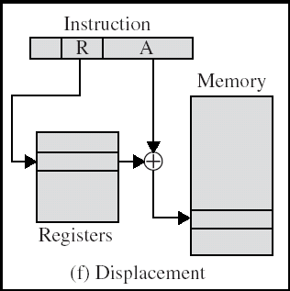
Displacement Addressing Diagram
Notes:
16

Slide 58
Displacement Addressing
EA = A + (R)
Effective address=start address + displacement
Effective address=Offset + (Segment Register)
Use direct and register indirect
Address field hold two values
  A = base value
  R = register that holds displacement
  or vice versa
Notes:
15

Slide 59
Base-Register Addressing
Base register addressing mode is used to implement inter segment transfer of control.
In this mode effective address is obtained by adding base register value to address field value.
  ADD AX,[BX][SI] Base indexed addressing mode
  ADD AX,[BX][SI + 20] Base index with displacement
Notes:
18

Slide 60
Memory: Indexed Addressing
The operand’s offset is the sum of the content of an index register SI or DI and an 8 bit or 16 bit displacement.
  mov AL,[SI + 5]
MOV AX, [SI +05]
Notes:
19

Slide 61
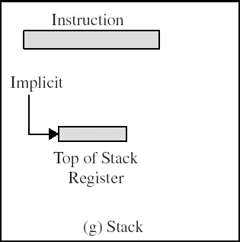
Stack Addressing
Operand is (implicitly) on top of stack
e.g.
  ADD Pop top two items from stack and add and push
Notes:
21

Slide 62
Instruction Cycle
Notes:
35

Slide 63

Instruction Cycle
Two steps:
  Fetch
  Execute

Slide 64

Instruction Cycle with Interrupts

Slide 65
Instruction Cycle
It is the time in which a single instruction is fetched from memory, decoded, and executed
An Instruction Cycle requires the following subcycle:
  FETCH
  EXECUTE
  INDIRECT
  INTERRUPT

Slide 66
Instruction Cycle
Fetch
Read next instruction from memory into the processor
Indirect Cycle (Decode Cycle)
May require memory access to fetch operands, therefore more memory accesses.
Interrupt
Save current instruction and service the interrupt
Execute
Interpret the opcode and perform the indicated operation
Notes:
35

Slide 67
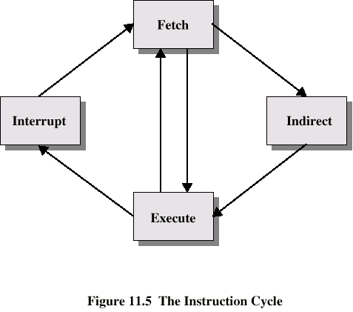
Instruction Cycle
Fetch
Fetch
Fetch
Fetch
Interrupt
Interrupt
Indirect
Indirect
Execute
Execute
Execute
Execute

Slide 68
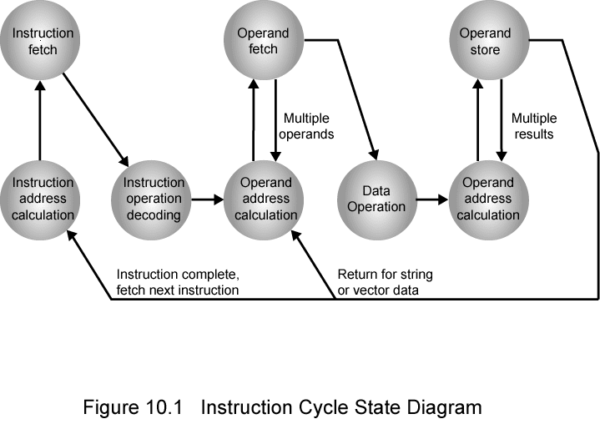
Instruction Cycle State Diagram

Slide 69
Instruction Cycle State Diagram
This illustrates more correctly the nature of the instruction cycle.
Once an instruction is fetched, its operand specifiers must be identified.
Each input operand in memory is then fetched, and this process may require indirect addressing.
Register-based operands need not be fetched.
Once the opcode is executed, a similar process may be needed to store the result in main memory.

Slide 70
Registers
Memory Address Register (MAR)
  Connected to address bus
  Specifies address for read or write op
Memory Buffer Register (MBR)
  Connected to data bus
  Holds data to write or last data read
Program Counter (PC)
  Holds address of next instruction to be fetched
Instruction Register (IR)
  Holds last instruction fetched/current instruction being executed

Slide 71
Fetch Cycle
Program Counter (PC) holds address of next instruction to be fetched
Processor fetches instruction from memory location pointed to by PC
Increment PC
  Unless told otherwise
Instruction loaded into Instruction Register (IR)
Processor interprets instruction and performs required actions

Slide 72
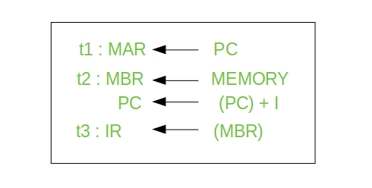
Fetch Sequence (symbolic)

Slide 73
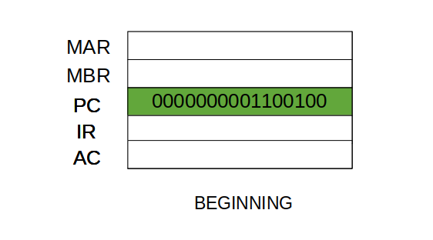
The Fetch Cycle –
At the beginning of the fetch cycle, the address of the next instruction to be executed is in the Program Counter(PC).

Slide 74
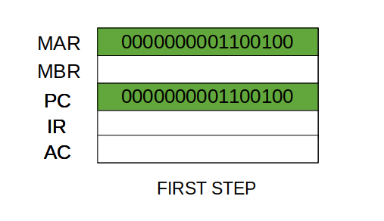
Step 1:
The address in the program counter is moved to the memory address register(MAR), as this is the only register which is connected to address lines of the system bus.

Slide 75
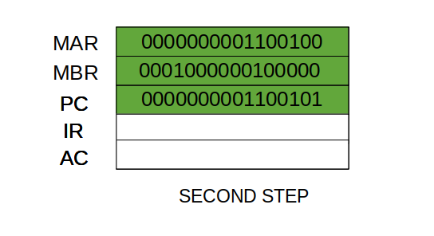
Step 2:
The address in MAR is placed on the address bus, now the control unit issues a READ command on the control bus, and the result appears on the data bus and is then copied into the memory buffer register(MBR).
Program counter is incremented by one, to get ready for the next instruction.(These two action can be performed simultaneously to save time)

Slide 76
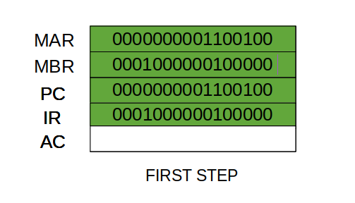
Step 3:
The content of the MBR is moved to the instruction register(IR)
THIRD STEP

Slide 77
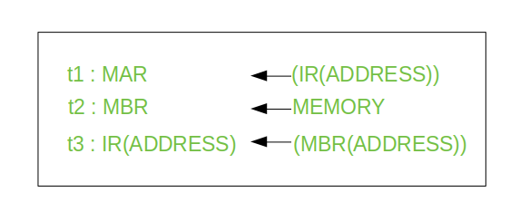
Indirect Cycle

Slide 78
Step 1:
The address field of the instruction is transferred to the MAR.
This is used to fetch the address of the operand.
Step 2:
The address field of the IR is updated from the MBR.(So that it now contains a direct addressing rather than indirect addressing)
Step 3:
The IR is now in the state, as if indirect addressing has not been occurred.

Slide 79
Interrupt Cycle
At the completion of the Execute Cycle, a test is made to determine whether any enabled interrupt has occurred or not.
If an enabled interrupt has occurred then Interrupt Cycle occurs.
The nature of this cycle varies greatly from one machine to another.

Slide 80
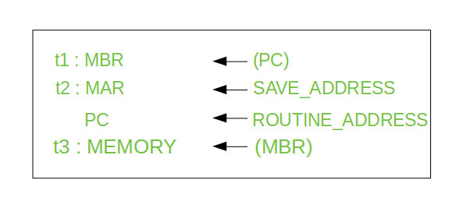

Slide 81
Step 1: Contents of the PC is transferred to the MBR, so that they can be saved for return.
Step 2: MAR is loaded with the address at which the contents of the PC are to be saved.
PC is loaded with the address of the start of the interrupt-processing routine.
Step 3: MBR, containing the old value of PC, is stored in memory.
  Note: In step 2, two actions are implemented as one micro-operation. However, most processor provide multiple types of interrupts, it may take one or more micro-operation to obtain the save_address and the routine_address before they are transferred to the MAR and PC respectively.a

Slide 82
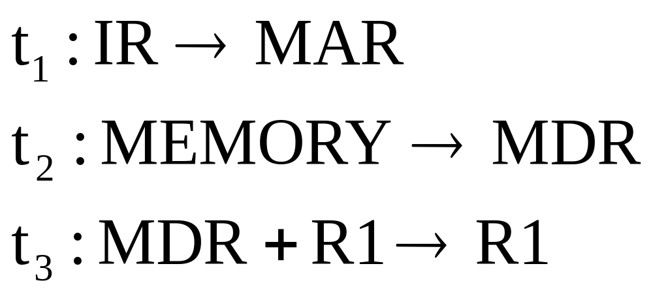
Execute Cycle (ADD)
Different for each instruction
e.g. ADD R1,X - add the contents of location X to Register 1 , result in R1

Slide 83
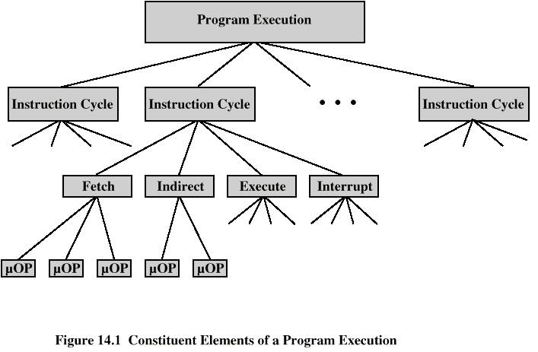
Constituent Elements of
Program Execution

Slide 84
Micro-Operations
A computer executes a program
Fetch/execute cycle
Each cycle has a number of steps
Called micro-operations
Each step does very little
Atomic operation of CPU

Slide 85
Types of Micro-operation
Transfer data between registers
Transfer data from register to external
Transfer data from external to register
Perform arithmetic or logical ops

Slide 86
William Stallings
Computer Organization and Architecture
8th Edition
Chapter 15
Control Unit Operation

Slide 87
Functional Requirements(of Control Unit)
Define basic elements of processor
Describe micro-operations processor performs
Determine functions control unit must perform

Slide 88
Registers
Memory Address Register (MAR)
  Connected to address bus
  Specifies address for read or write op
Memory Buffer Register (MBR)
  Connected to data bus
  Holds data to write or last data read
Program Counter (PC)
  Holds address of next instruction to be fetched
Instruction Register (IR)
  Holds last instruction fetched/current instruction being executed

Slide 89
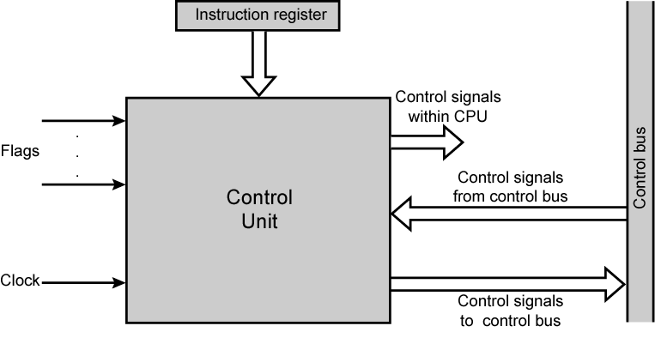
Model of Control Unit

Slide 90
Functions of Control Unit
Sequencing
  Causing the CPU to step through a series of micro-operations
Execution
  Causing the performance of each micro-op
This is done using Control Signals→→

Slide 91
Control Signals( input )
Clock
  One micro-instruction (or set of parallel micro-instructions) per clock cycle
Instruction register
  Op-code for current instruction
  Determines which micro-instructions are performed
Flags
  State of CPU
  Results of previous operations
From control bus
  Interrupts
  Acknowledgements

Slide 92
Control Signals - output
Within CPU
  Cause data movement
  Activate specific functions
Via control bus
  To memory
  To I/O modules

Slide 93
Control Unit Organization

Slide 94
Implementation
All the control unit does is generate a set of control signals
Each control signal is on or off
Represent each control signal by a bit
Have a control word for each micro-operation
Have a sequence of control words for each machine code instruction
Add an address to specify the next micro-instruction, depending on conditions

Slide 95
William Stallings
Computer Organization and Architecture
8th Edition
Chapter 16
Micro-programmed Control

Slide 96
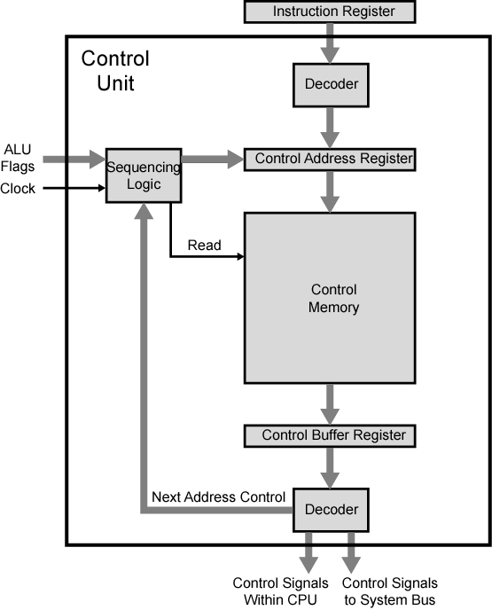
Functioning of Micro programmed
Control Unit

Slide 97
Micro programmed Control Unit Function
Sequence logic unit issues read command
Word specified in control address register is read into control buffer register
Control buffer register contents generates control signals and next address information
Sequence logic loads new address into control buffer register based on next address information from control buffer register and ALU flags

Slide 98
Next Address Decision
Depending on ALU flags and control buffer register
  Get next instruction
    Add 1 to control address register
  Jump to new routine based on jump microinstruction
    Load address field of control buffer register into control address register
  Jump to machine instruction routine
    Load control address register based on opcode in IR

Slide 99
Advantages and Disadvantages of Microprogramming
Simplifies design of control unit
  Cheaper
  Less error-prone
Slower

Slide 100
Tasks Done By Microprogrammed Control Unit
Microinstruction sequencing
Microinstruction execution
Must consider both together

Slide 101
Micro-instruction Types
Each micro-instruction specifies many different micro-operations to be performed in parallel
  (horizontal micro-programming)
Each micro-instruction specifies single (or few) micro-operations to be performed
  (vertical micro-programming)

Slide 102
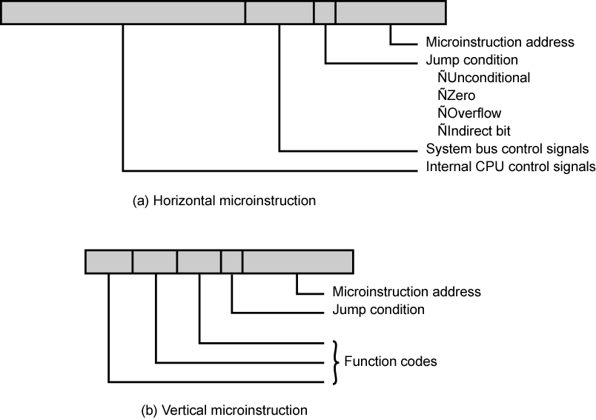
Typical Microinstruction Formats

Slide 103
Vertical Micro-programming
Width is narrow
Limited ability to express parallelism
Considerable encoding of control information requires external memory word decoder to identify the exact control line being manipulated

Slide 104
Horizontal Micro-programming
Wide memory word
High degree of parallel operations possible
Little encoding of control information

Slide 105
William Stallings
Computer Organization and Architecture
7th Edition
Chapter 13
Reduced Instruction Set Computers
v/s
Complex Instruction Set Computers

Slide 106
Introduction
THE ARCHITECTURAL DESIGN of the CPU is RISC & CISC.
Hardware fused with software (Intel v/s Apple)
Intel’s hardware oriented approach →CISC while that of Apple is RISC
Instruction Set Architecture- Interface to allow easy communication between the programmer and the hardware.
ISA- execution of data, copying data, deleting it, editing
Instruction Set , Addressing Modes,

Slide 107
RISC-Reduced Instruction Set Computer
RISC processor design has separate digital circuitry in the control unit
Signals needed for the execution of each instruction in the instruction set of the processor.
Examples of RISC processors:
  IBM RS6000, MC88100
  DEC’s Alpha 21064, 21164 and 21264 processors

Slide 108
CISC-Complex Instruction Set Computer
Control unit →micro-electronic circuitry
- generates a set of control signals →activated by a micro-code
The primary goal of CISC architecture is to complete a task in as few lines of assembly code as possible.
Examples of CISC processors are:
  Intel 386, 486, Pentium, Pentium Pro, Pentium II, Pentium III
  Motorola’s 68000, 68020, 68040, etc.

Slide 109
CISC processor features
Instruction set with 120-350 instructions
Variable instruction/data formats
Small set of general purpose registers(8-24)
A large number of addressing modes
High dependency on micro program
Complex instructions to support HLL features

Slide 110
CISC processor features
Complex pipelining
Many functional chips needed to design a computer using CISC
Difficult to design a superscalar processor

Slide 111
RISC processor features
Instruction set with limited number of instructions
Simple instruction format
Large set of CPU registers
Very few addressing modes
Easy to construct a superscalar processor

Slide 112
RISC processor features
Hardwired control unit for sequencing microinstructions
Supports on chip cache memory
All functional units on a single chip
Simple pipelining

Slide 113
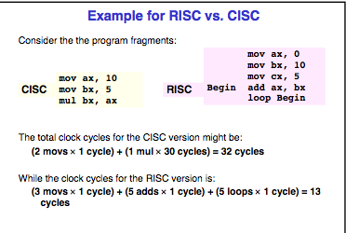

Slide 115
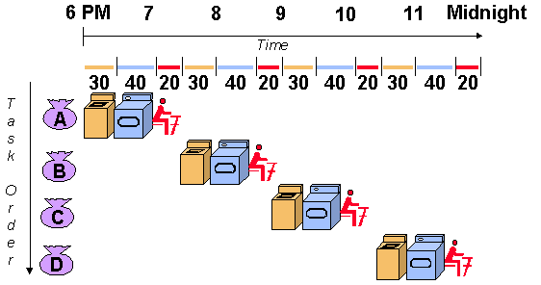
PIPELINING-Ex Laundry Analogy

Slide 116
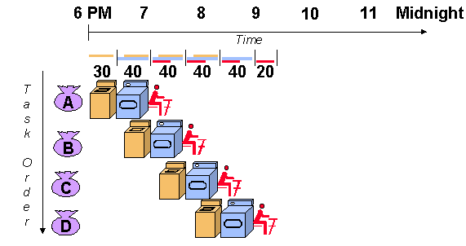

Slide 117
Problems with pipeline
Stalling of pipeline
  Data Dependency
  Branch,etc…

Slide 118
RISC Pipelining
Most instructions are register to register
Two phases of execution, I E
  I: Instruction fetch
  E: Execute
    ALU operation with register input and output
For load and store(memory),I E D
  I: Instruction fetch
  E: Execute
    Calculate memory address
  D: Memory
    Register to memory or memory to register operation

Slide 119
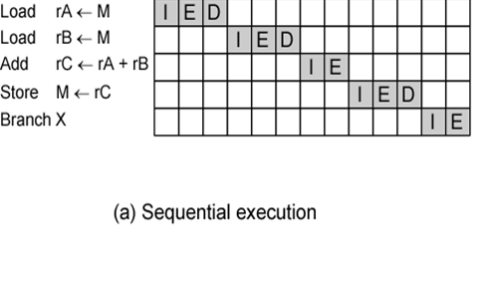

Slide 120
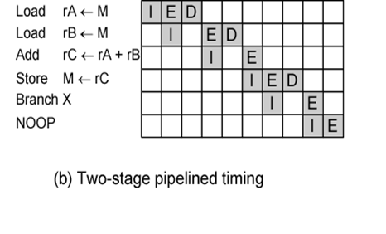
NOP is typically used to generate a delay in execution or to reserve space in code memory.

Slide 121
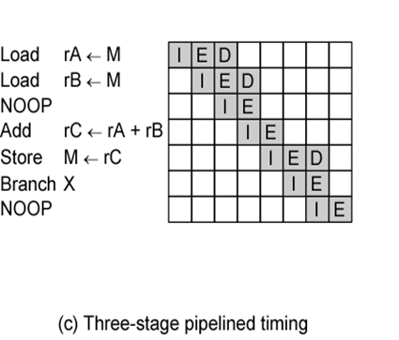

Slide 122
RISC Architecture
9 functional units interconnected by multiple data paths with width ranging from 32-128 bits
All internal- external buses are 32 bit wide
Separate instruction (4KB)and data cache(8KB)
MMU- implements paged virtual memory structure
RISC integer unit executes load,store,fetch etc
2 floating point units , multiplier unit and adder unit
Graphics unit to support 3D drawing

Slide 123
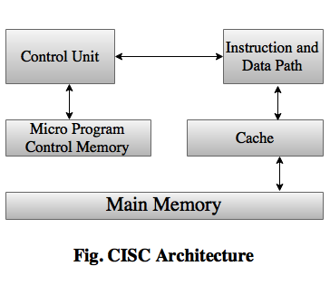
CISC Architecture

Slide 124
